Slide 1
Time Series Forecasting
PyData Meetup November 28th
Ben Reeves

Slide 2
Who uses time series
Demand forecasting
Uber,
Microsoft
Wal-Mart
Markets and Economy
Hedge funds, investment companies, banks
Supply Forecasting
Energy companies
Commodity producers
Economic indicators

Slide 3
Unique Challenges of Time Series Data
Extrapolation problem - is our training data representative?
More pronounced in time series
Uncertainty estimation
Forecasts are more useful with confidence intervals
Traditional train test splits, cross validation fails
Forward looking information is introduced

Slide 4
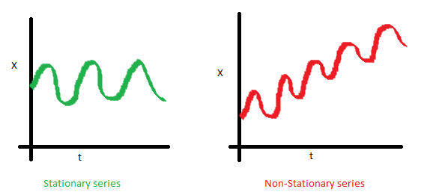
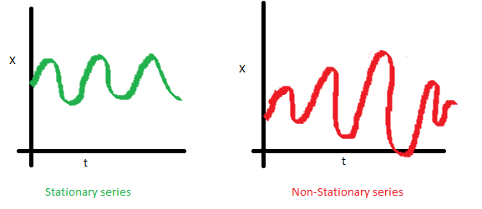
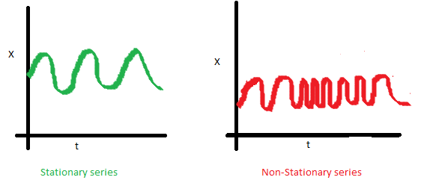
Import concepts
Stationarity
Memory
Autoregression, autocorrelation
Seasonality, trend, cycles
Exogenous vs endogenous
Homo/heteroskedacity
Markov property

Slide 5
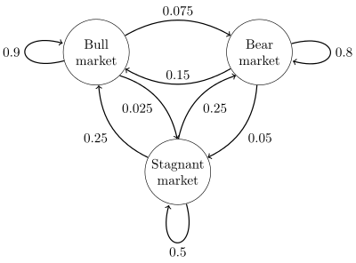
The Markov Property
The future state is entirely dependent on previous state plus stochastic processes
Effectively introducing the markov property into your time series is can be critical for non-time aware models
For traditional models such as decision trees or logistic regression, feature engineering is necessary
Some deep learning models (LSTMs) encode state and can be seen as learning internal state for which the markov property holds for a given time horizon
Reinforcement learning models technically need the markov property to hold in order to mathematically prove convergence

Slide 6
Practical Techniques
Testing stationarity
Train/test/evaluation
Derived features

Slide 7
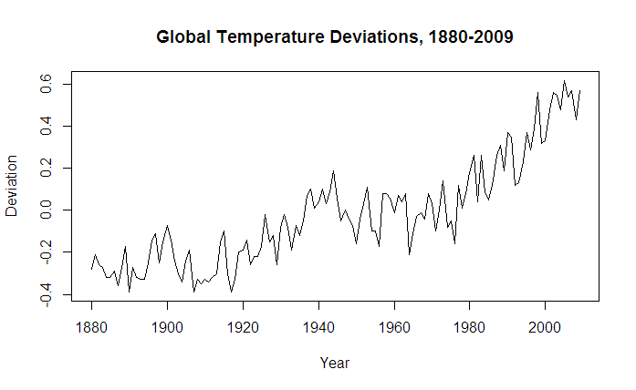
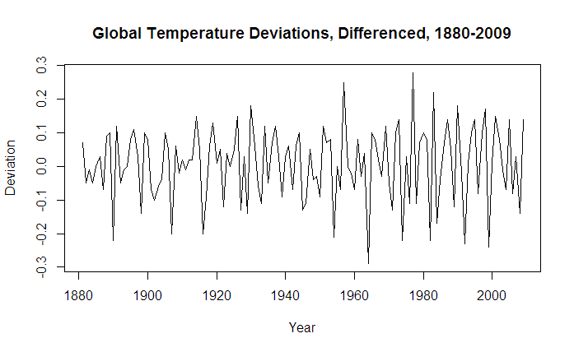
Dealing with non-stationarity
Applying differences, log differences, and numerical differentiation are common techniques
Eg Box-Jenkins method for ARIMA recommends taking the first difference plus additional differences for seasonality
Additional transformations (log, sqrt, detrending, filtering outliers) can also be applied

Slide 8
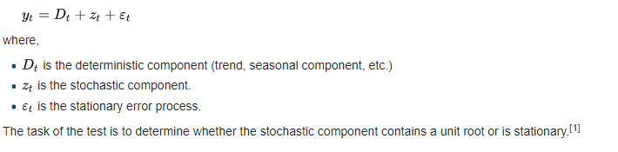
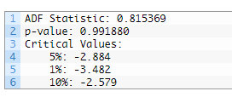
Testing for Stationarity
*Always* requires making assumptions about the underlying nature of the dataset. Be cognizant of your assumptions
Augmented dickey fuller test (ADF) most common mechanism to test stationarity
Type of unit root test
Null hypothesis is that unit root is present in a time series sample
Statsmodels package has built in adf functions
 | from pandas import Series from statsmodels.tsa.stattools import adfuller series = Series.from_csv('international-airline-passengers.csv', header=0) X = series.values result = adfuller(X) print('ADF Statistic: %f' % result[0]) print('p-value: %f' % result[1]) print('Critical Values:') for key, value in result[4].items(): print('\t%s: %.3f' % (key, value))

Slide 9
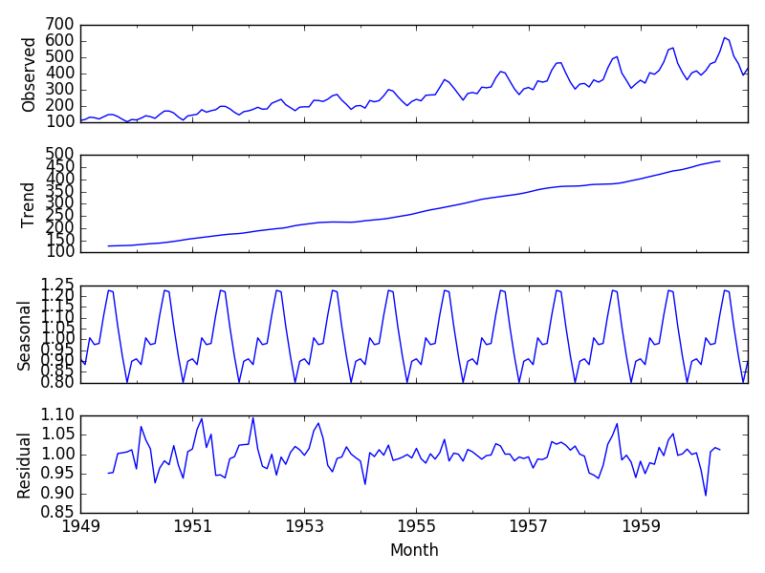
Decomposing Trend and Seasonality
Statmodels package has great support, esp with datetime indexed pandas objects
3 4 5 6 7 | from pandas import Series from matplotlib import pyplot from statsmodels.tsa.seasonal import seasonal_decompose series = Series.from_csv('airline-passengers.csv', header=0) result = seasonal_decompose(series, model='multiplicative') result.plot() pyplot.show()

Slide 10
Feature Engineering
Lagged data points, moving averages, derivatives, statistical moment arms
Critical for traditional models, may help with deep learning models to improve convergence and encode long term information
Eg LSTM memory gates might not hold past data long enough. Including eg longer term moving averages and lags can help the model
Smoothing and signal processing
Frequecy analysis, eg wavelet transform and fourier analysis
The package tsfresh is a good resource for automating feature engineering, although I’ve found it to be very computationally expensive

Slide 11
The war against forward information
Accidentally encoding future information into your model is dangerously easy. Significant precautions need to be taken
PCA
If using PCA or other dimensionalty reduction tools, you must perform a walkforward fit/transform
NB: when doing this practically, the direction of your eigenvectors may reverse and must be corrected for
Feature selection
Correlations and other relationships between variables which might be known ex-post were not known at the time of the model’s training
Data availability
Sometimes data is made available after the fact, but dated to a time when it was not known
Prime example is economic data, eg unemployment rates. Data for Octover 2018 is not known until November 2018, but dated as Oct

Slide 12
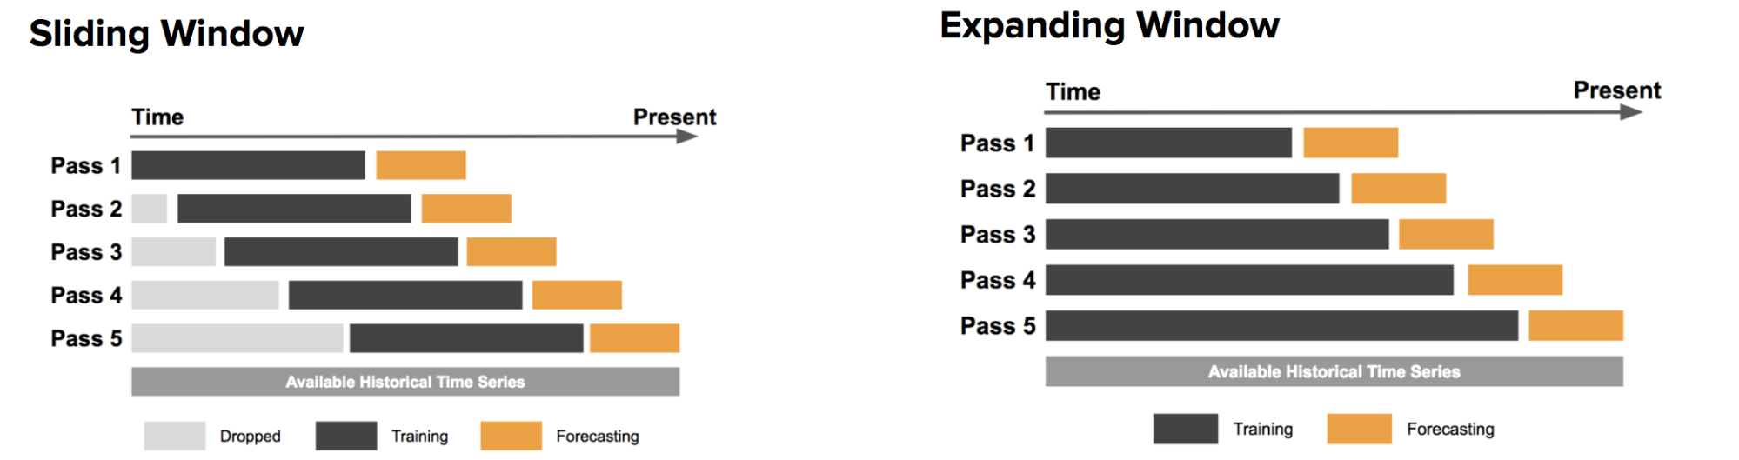
Train Test Split
Random splits introduce forward looking information that was not available at the time of the forecast
Train and testing can be performed instead using walk-forward type windows
Sliding windows drop past information that may no longer be relevant, eg during regims shifts
Expanding windows assume all historical information could be important
Cross validation can be performed on an embargoed window, such as the most recent period

Slide 13
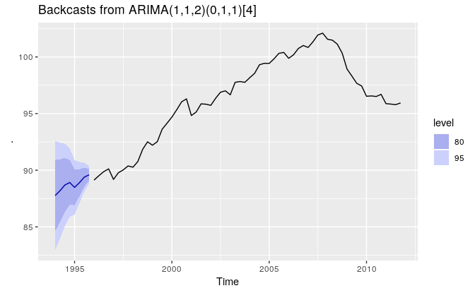
Backtesting
Using sliding/expanding windows to continually train/test/eval your model against an embargoed portion of data
Resliency:
Is the model resilient to the introduction of uniform or non-uniform gaussian noise?
Backcasting: A (sometimes) useful tool
If your series is truly stationary, you may be able to simply ‘forecast’ past data by reversing the chonological order of your data
Issues with exogenous data series
In low information time series (eg stock markets) the historical path represents only one of the possible paths that could have occurred.

Slide 14
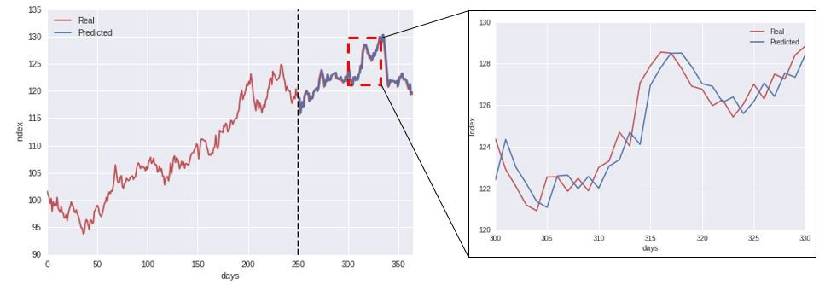
ML Forecasting Gone Wrong
Random walk below being predicted with R²=0.9
‘Forecast’ in this case is just predicting the last data point
First order differencing should have been applied. Predictive power drops to 0 afterwards
Be careful how you measure success. The models will deliver what you ask
Personal experience with consultant. Used traditional train/test split and xgboost classifier, accuracy ~95%. After switching to a walk-forward train/test model, accuracy dropped to 50% for binary classifier

Slide 15
Model Selection
Traditional forecasting models
Traditional ML/Statistical learning techniques
Deep learning

Slide 16
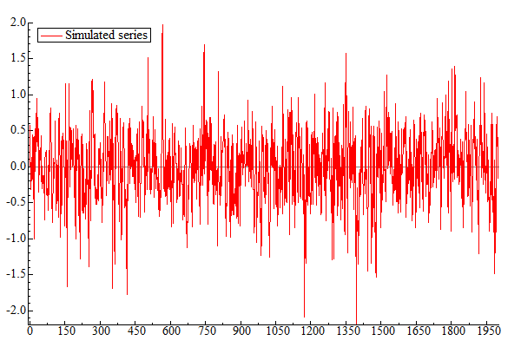
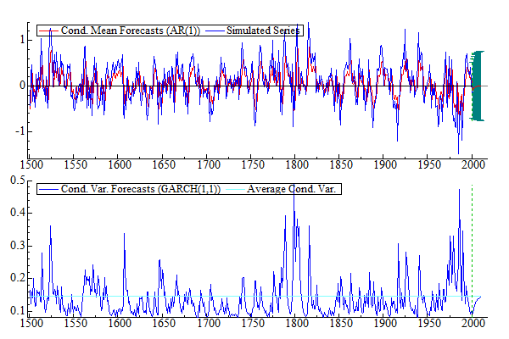
Traditional Forecasting Models
Autoregressive models
ARMA/ARIMA. Differencing → ARIMA
VAR
GARCH
Very strong assumptions about stationarity in all these models
Box-Jenkins approached states that non stationary data can be made stationary through differencing
ARMA/ARIMA represent unidirectional relationships of predictor → forecast
VAR generalize this futher to allow for bidirectional relationships
ARIMA: conditional mean GARCH: conditional variance

Slide 17
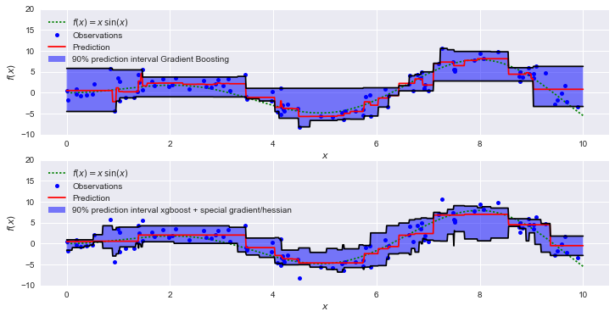
Forecasting with Traditional ML Models
Regression models
Ridge, Lasso, ElasticNet, SVR, etc
Decision trees/forests
Discrete predictions
These models are not time aware
Significant feature engineering required
Attempt to transform the time series into a multidimensional space with the markov property
In some cases, classifiers can also be used where future state (eg increase/decrease beyond a threshold) is desired

Slide 18
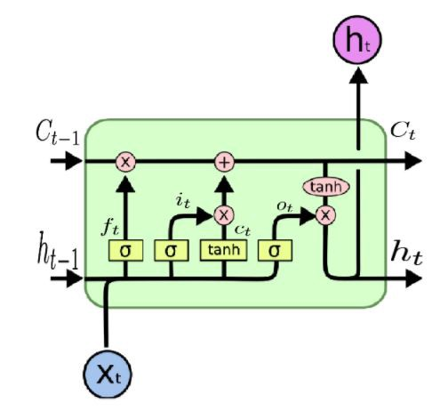
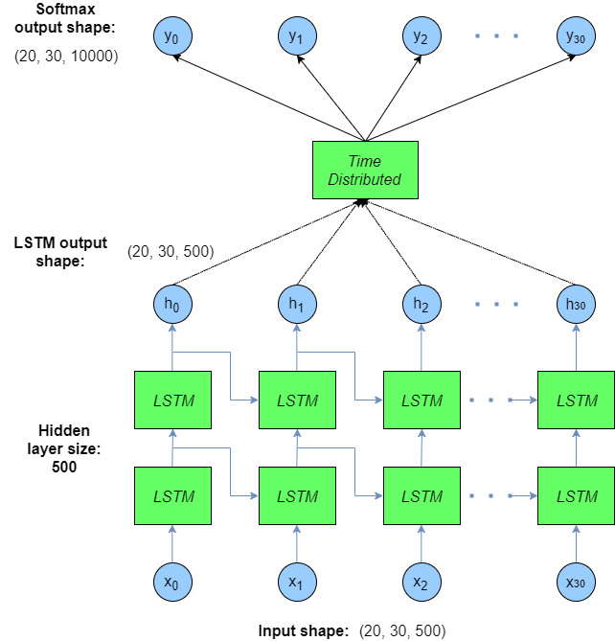
Deep Learning Forecasting
Long short term memory RNNs (LSTM)
Other RNNs
Time delay neural network (TDNN)
Recurrent networks ‘unravel’ during training/prediction
Encode prior predictions and prior state at t-1…t-n
LSTMs can be thought of as markov transforms over the lookback period
Ability to ‘remember’ dependencies between inputs across time delays. Vanishing gradient problem
Feature engineering can still be necessary if long term dependencies exist which are greater than the lookback period

Slide 19
(Briefly) Dealing with Uncertainty
Traditional Models
Confidence intervals built in to ARIMA
AFAIK no direct method of measuring forecast uncertainty with VARs. Bootstrapping and Bayesian VARs are referenced
ML Models
Quantile prediction using tree methods
Currently do not know of any mechanisms for forecast uncertainty using linear models
Deep learning
Essentially run multiple predictions with random dropout to create a distribution of outputs
As of writing, I am unclear if this approach applies to RNNs
Bayesian Neural Networks are receiving attention around uncertainty estimation in deep learning models
Additional resources:
https://towardsdatascience.com/regression-prediction-intervals-with-xgboost-428e0a018b
http://mlg.eng.cam.ac.uk/yarin/blog_3d801aa532c1ce.html
https://arxiv.org/abs/1709.01907
https://scottlocklin.wordpress.com/2016/12/05/predicting-with-confidence-the-best-machine-learning-idea-you-never-heard-of/
https://fairyonice.github.io/Measure-the-uncertainty-in-deep-learning-models-using-dropout.html

